Slide 1
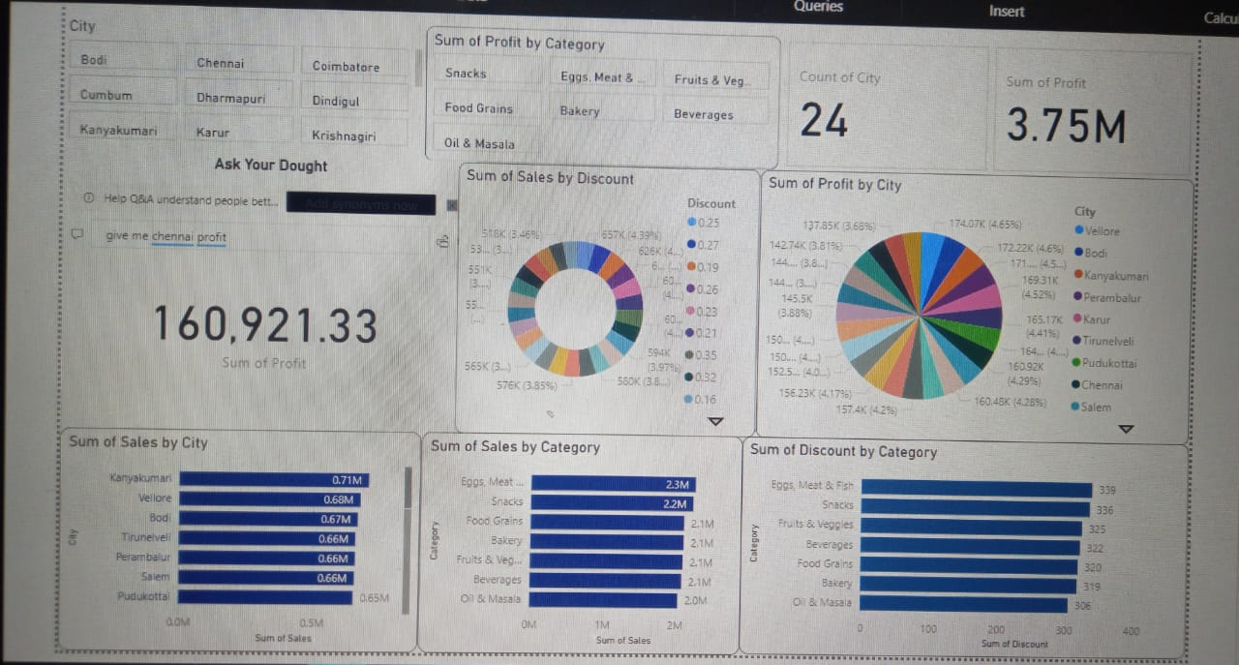
Super Market Sales Reviews
K.Kanaka Maha Lakshmi.

Slide 2
1.Key Metrics Summary
Title:Key Performance Indicators
Content
Total sales:Rs160,921.33
Total Profit:Rs3.75 Million
Total Count:24(likely representing items,categories,or orders)

Slide 3
2.Sales by City and Category
Sales Performance
Content
Top Cities by Sales:
Kanayakumari-0.7M
Bodi-0.682M
Karur-0.67M
Top Categories by Sales:
Snacks-2.3M
Eggs&Meat-2.2M

Slide 4
3.Profit by City Content
Profit Analysis
Pie chart showing profit Distribution among cities.
Cities like Vellore,Bodhi,and Chennai show significant contributions.

Slide 5
4.Discount Insights
Discount Distribution
Content:
By Discount Type(Donut chart)
By Category(Bar chart):
Categories like Bevarages,Bakery,and Diary show varying discount levels.

Slide 6
5.Bussiness Insights
Summary&Recommendations
content:
Focus Marketing Efforts on high-profit cities.
Consider optimizing discount Strategies for low-Profit categories.
Expand high –Sales categories like snacks and Eggs&Meat for higher revenue

